Slide 1
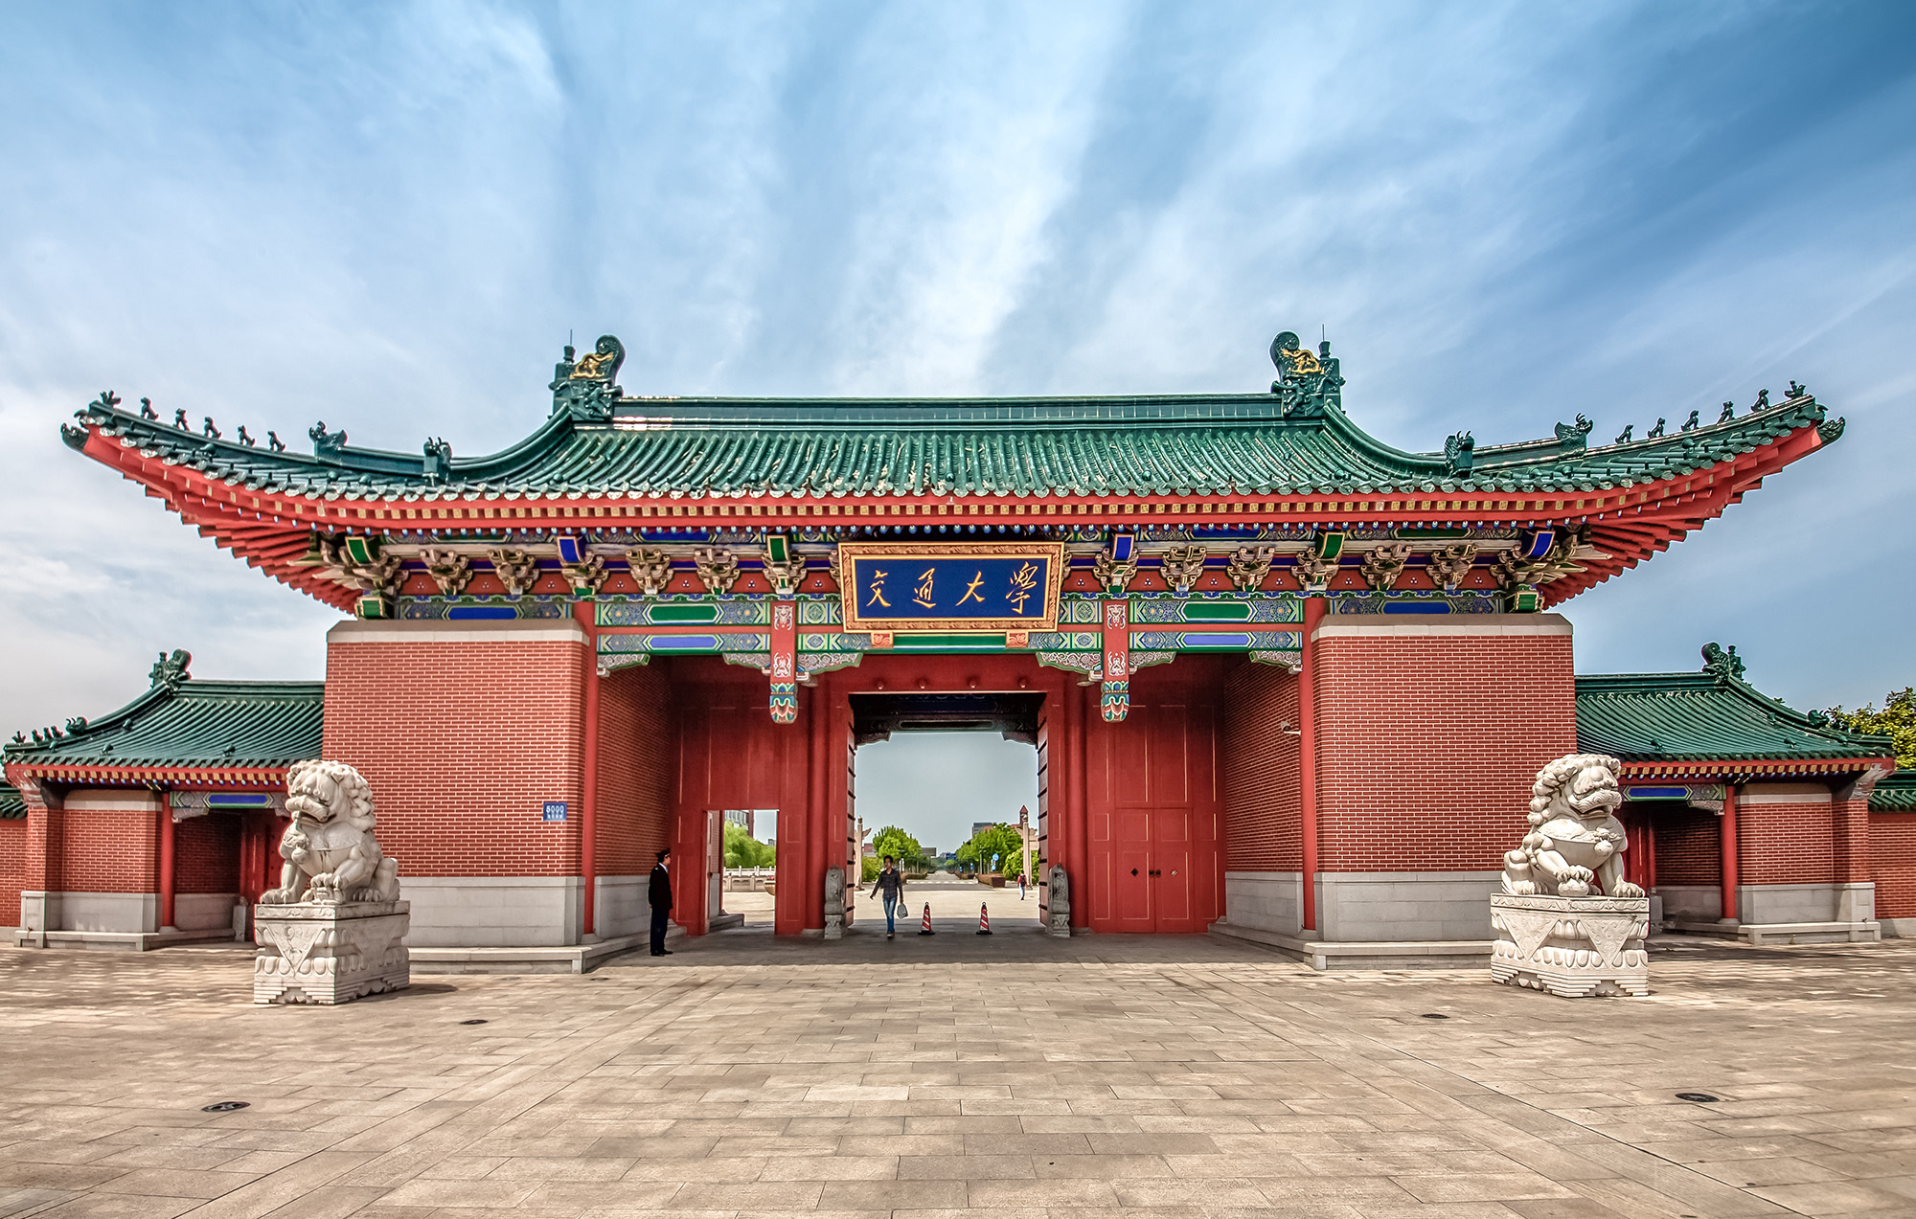
Algorithm Group Project: Object Removal
Weixiong Lin, Ren Zhou, Wentao Zhao

Slide 2
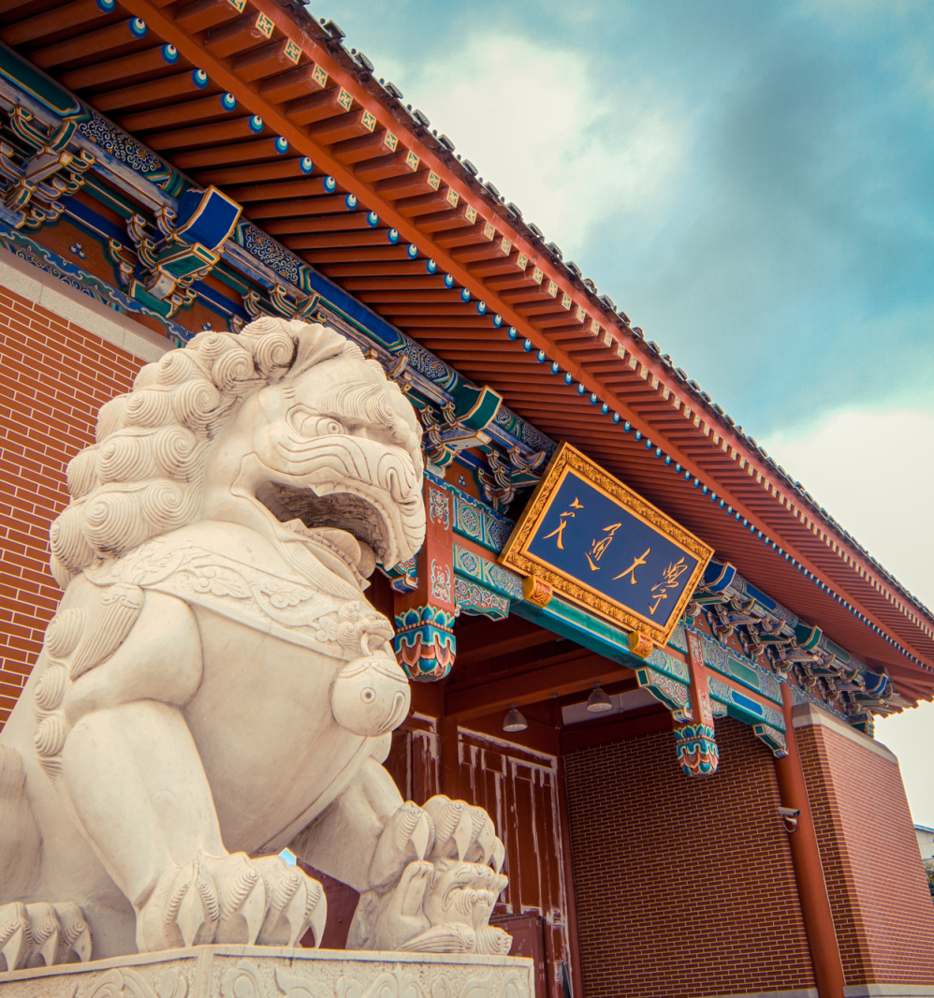
1
Background
2
Sketch
Contents
3
Find Contour
4
Object Removal
5
Summery
Notes:
我们的答辩会分为以下5个部分（停顿一下）

Slide 3
Background
01

Slide 4
Sketch
02

Slide 5
Find Contour
03

Slide 6
Object Removal
04

Slide 7
Object Removal
04

Slide 8
Object Removal
Idea: construct a graph in which edges have costs determined by energy of their end points. Assign negative costs to edges that are incident to pixels to be removed. Repeat finding paths with the lowest energy and remove them until all the pixels user want to remove are deleted.

Slide 9
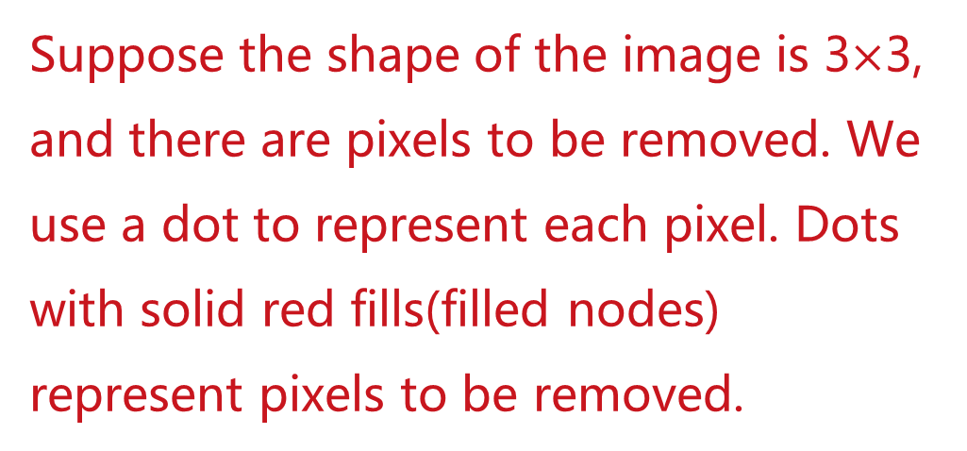
Object Removal
Minimum cost network flow
Suppose the shape of the image is 3$×$3, and there are pixels to be removed. We use a dot to represent each pixel. Dots with solid red fills(filled nodes) represent pixels to be removed.
image

Slide 10
Object Removal
1
Minimum cost network flow
2
2
add two nodes at the top and one node at the bottom
split each node into two nodes
all edges except the top one has unit capacity
the top edge’s capacity is the number of paths I will find, which is 2 in this graph
1
1
1
1
1
1
1
1
1
1
1
1
1
1
1
1
1
1
1
1
1
1
1
1
1
t
the capacity of each edge

Slide 11
Object Removal
1
Minimum cost network flow
0
2
multiply the energy of filled nodes by -1000
define the energy of 1, 2 and t to be 0
for edges crossing horizontal layers, the cost of an edge is half of the sum of its end points’energy
for horizontal edges, the cost is 0
3
20
100
0
0
0
100
-1230
-2011
-1982
-987
0
0
0
20
109
-1672
-1542
-1432
0
0
0
32
19
45
t
the cost of each edge (one possible scenario)

Slide 12
Object Removal
1
Minimum cost network flow
0
2
find the max flow with minimum cost
remove nodes on those paths
repeat the above process from constructing graph to removing nodes, until all the filled nodes are removed
3
20
100
0
0
0
100
-1230
-2011
-1982
-987
0
0
0
20
109
-1672
-1542
-1432
0
0
0
32
19
45
t

Slide 13
Object Removal
Remove nodes on paths
这一页有必要写？

Slide 14
Object Removal
Retain the shape of the image
while the width of the image is smaller than original value
construct graph
run max flow with minimum cost algorithm
…
待补全

Slide 15
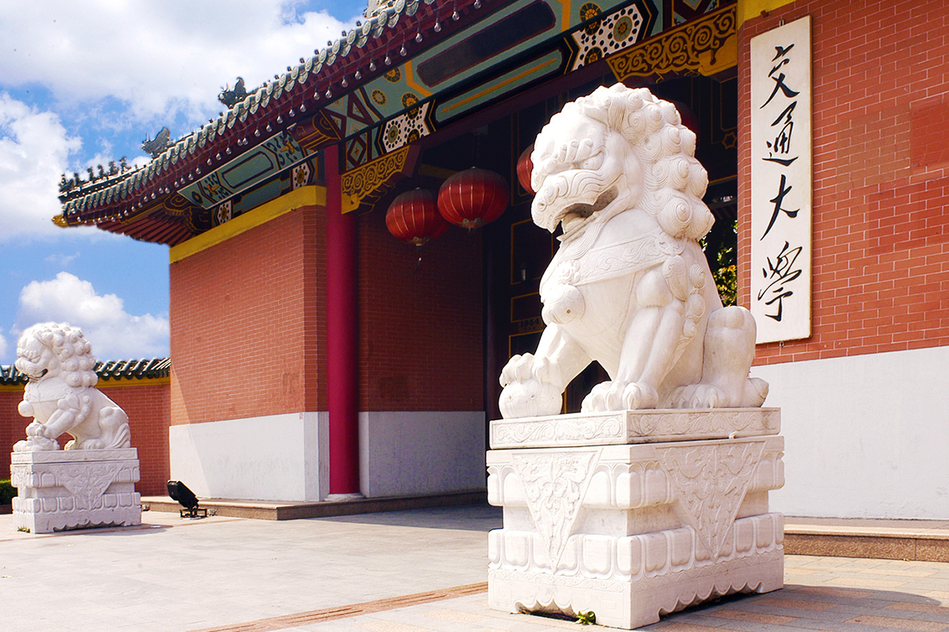

Many Thanks

